Slide 1
Capstone Project Liyana Roslie
The important keywords in Data Science Industry

Slide 2
TABLE OF CONTENTS
03
04
DATA PREPROCESSING
DATA EXPLORATION
05
06
TOPIC MODELLING
CHALLENGES
01
02
GOAL & PROBLEM STATEMENT
DATASET OVERVIEW
What to achieve for this project
What the data is about
How to clean the data
What insights can be derived from data
How to conduct topic modelling
What kind of challenges encountered
07
FUTURE PLANS
How to expand on the project

Slide 3
01
GOAL & PROBLEM STATEMENT
What to achieve for this project

Slide 4

GOAL
As a Data Science student who is about to graduate, I will like to find out if there are missing skillsets, knowledge, etc that I can address before entering the job market and the areas that I can work on to progress well in my Data Science career

Slide 5

PROBLEM STATEMENT
Find what are topics or keywords or domains that are relevant and important in the Data Science industry to improve the prospects of landing a Data Science job and excel in Data Science career

Slide 6
02
DATASET OVERVIEW
What the data is about

Slide 7

DATASET OVERVIEW
2 different datasets:
Blog articles data from towardsdatascience.com
Job listings from glassdoor.com
towardsdatascience.com contains articles on work done in practical industry applications as well as research work in the academic field.
glassdoor.com contains job listings drawn up by employers that highlight the desired skillset and knowledge that the ideal candidate should have.
represent the entry to Data Science(DS) industry and could give a sense of what kind of DS skills that are more sought after. However, as DS job market is still quite new, it might not represent the actual important skillsets but rather just the employer’s assumption
Dataset is collected on July 10, 2020 from glassdoor US
Analyse and compare these 2 different datasets’ keywords to gain a better understanding of the DS industry.

Slide 8
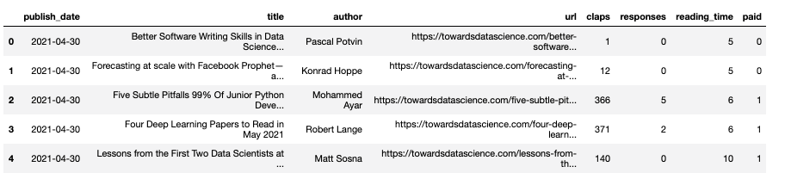
ARTICLE DATASET OVERVIEW
https://www.kaggle.com/annpastushko/towards-data-science-articles-dataset-20102021
TowardsDataScience articles since 2010
Initial: 42,660 rows of data, After cleaning: 42,220 rows of data
Has duplicated content and some URL has been taken down
Require further extraction of articles content via URL through web scraping

Slide 9
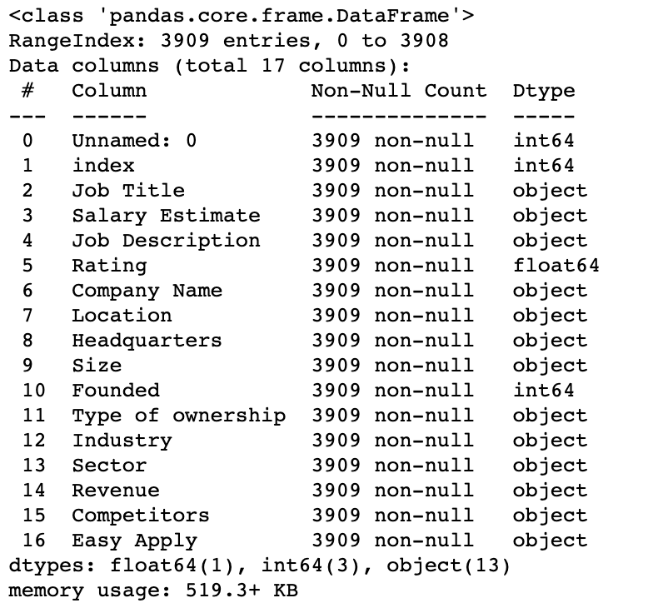
JOB LISTINGS DATASET OVERVIEW
https://www.kaggle.com/andrewmvd/data-scientist-jobs
DS related job listings scraped from glassdoor.com on July 2020 in the USA region
Initial: 3909 rows of data
After cleaning: 3690 rows of data
Missing data listed as -1
Has some duplicate jobs listings

Slide 10
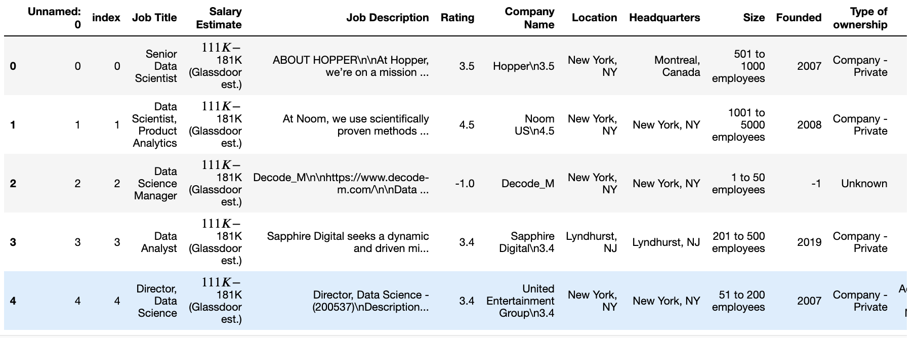
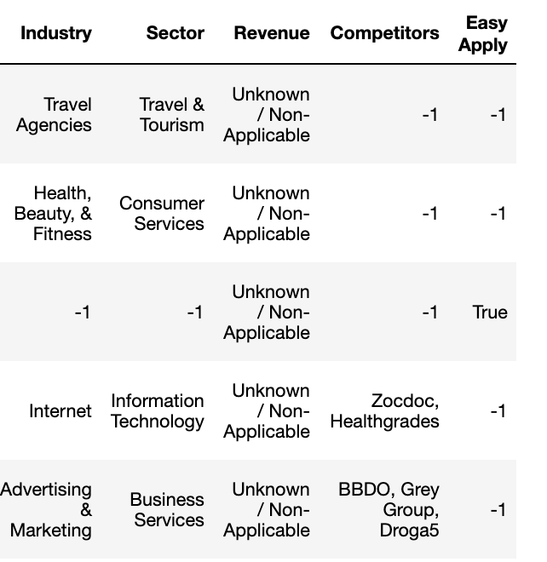
JOB ARTICLE DATASET OVERVIEW

Slide 11
03
DATA PREPROCESSING
How to clean the data

Slide 12

DATASET PREPROCESSING OVERVIEW
For both EDA and Topic Modelling:
Remove punctuation, escape characters, special characters including HTML markups, emojis, remove duplicate contents, define extra stopwords and remove them
Make relevant data to be all in lowercase
In articles content data:
Remove articles with missing content. Some URLs has been taken down
Remove author name
Remove first phrase which includes reading time summary
In jobs description data
Extract company name in company column before “\n” appears
Remove company name

Slide 13
DATASET PREPROCESSING
In Topic Modelling ONLY:
Lemmatize: change words to noun
Stem : reduce words to root form
Convert a document into list of tokens
Prepare list of tokens into
Bag of words
TF-IDF

Slide 14
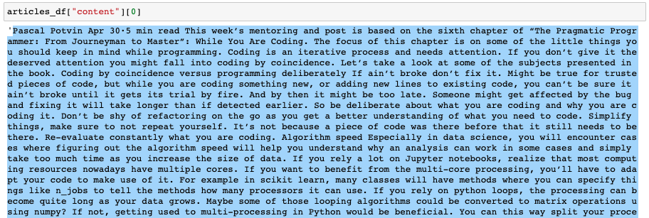
ARTICLE DATASET PREPROCESSING EXAMPLE
Mix of lowercase and uppercase
Author’s name
Reading time

Slide 15
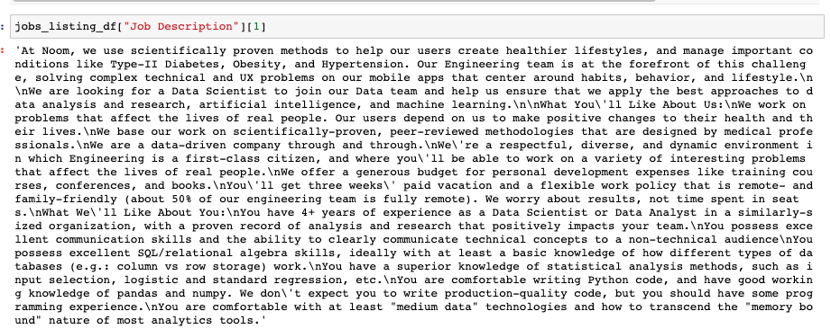
JOBS LISTINGS DATASET PREPROCESSING EXAMPLE
Mix of lowercase and uppercase
Company’s name
Escape character

Slide 16
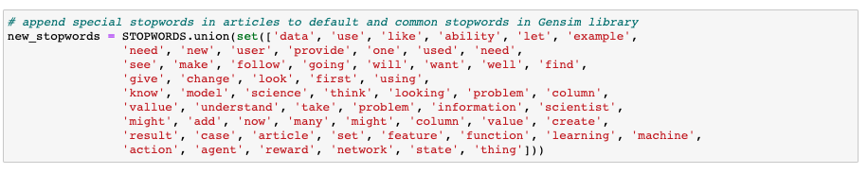
ARTICLES STOPWORDS EXAMPLE
Frequently used words in articles
Doesn’t provide clues as keywords

Slide 17
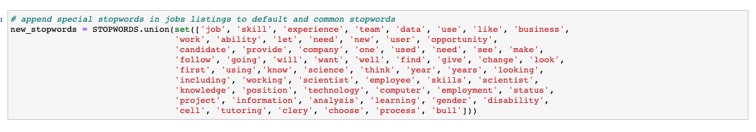
JOBS LISTINGS STOPWORDS EXAMPLE
Separate from articles
Some overlaps or common stopwords in articles
Frequently used words in articles
Doesn’t provide clues as keywords
Notes:
Example: year or years will be useful if it appears in article’s content as it might indicate the article contain subjects relating to date formatting or time series but it is not useful to appear in job’s description as it employers mainly list how many years of experience they would like the ideal candidate to have for certain skillsets or knowledge

Slide 18
04
DATA EXPLORATION
What insights can be derived from data

Slide 19

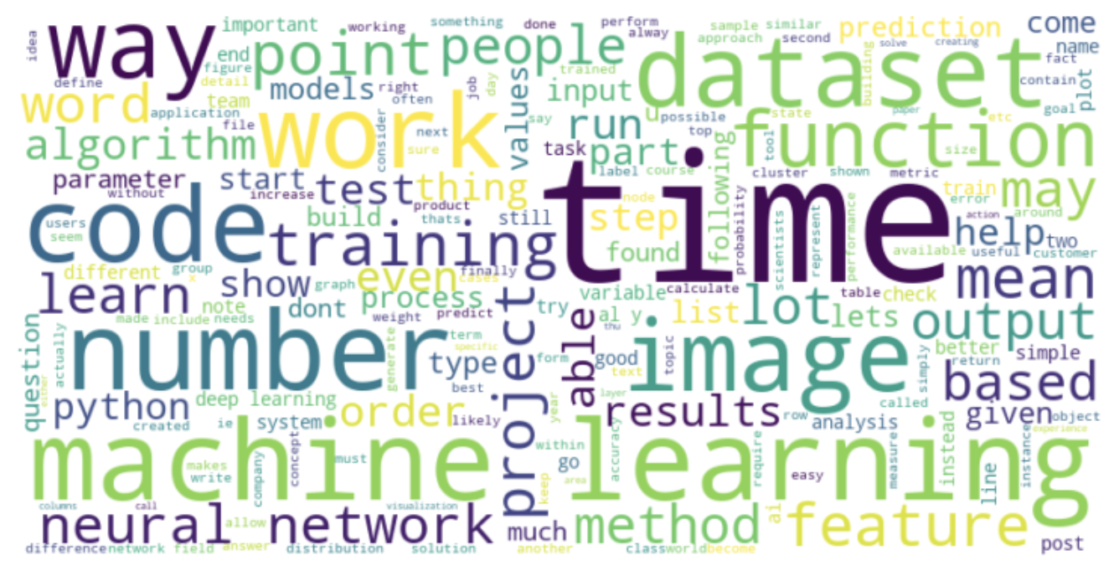
MOST FREQUENT WORDS IN ARTICLES
dataset
image
time
neural network
machine learning
function
code
project
training
feature
Popular branch of ML: computer vision, time series, neural network
Creating dataset through web scraping and handling imbalanced dataset
Feature engineering
Project ideas

Slide 20

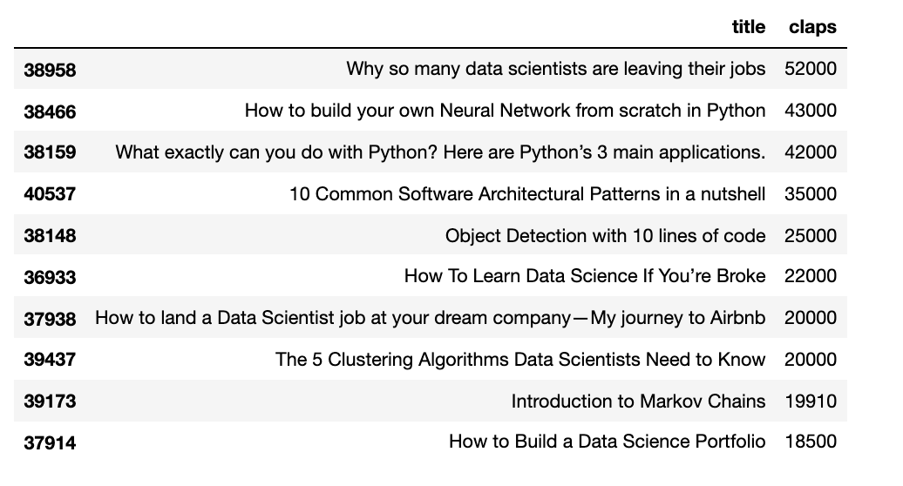
TOP 10 ARTICLES WITH MOST CLAPS
Computer Vision
Neural Network
Python language for Data Science
Data Science algorithms
Data Science career
More informative topics
Popular branch of ML: computer vision, neural network
Coding in Python language
Different algorithms in DS and career entry and growth

Slide 21

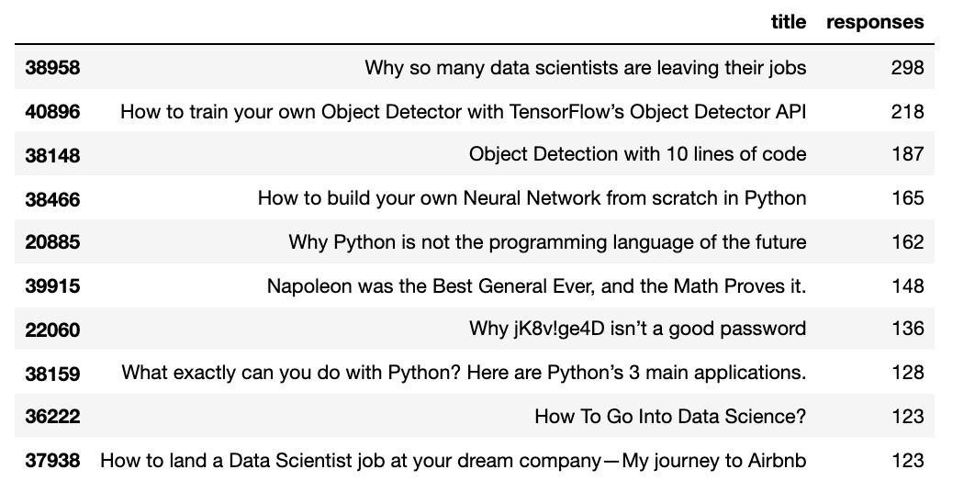
TOP 10 ARTICLES WITH MOST RESPONSES
Neural Network
Python
Data Science career
Computer Vision
Controversial headlines
Not all articles are the same as the articles with most claps but still similar topic results
Difference is the headlines provoke controversy and debate

Slide 22

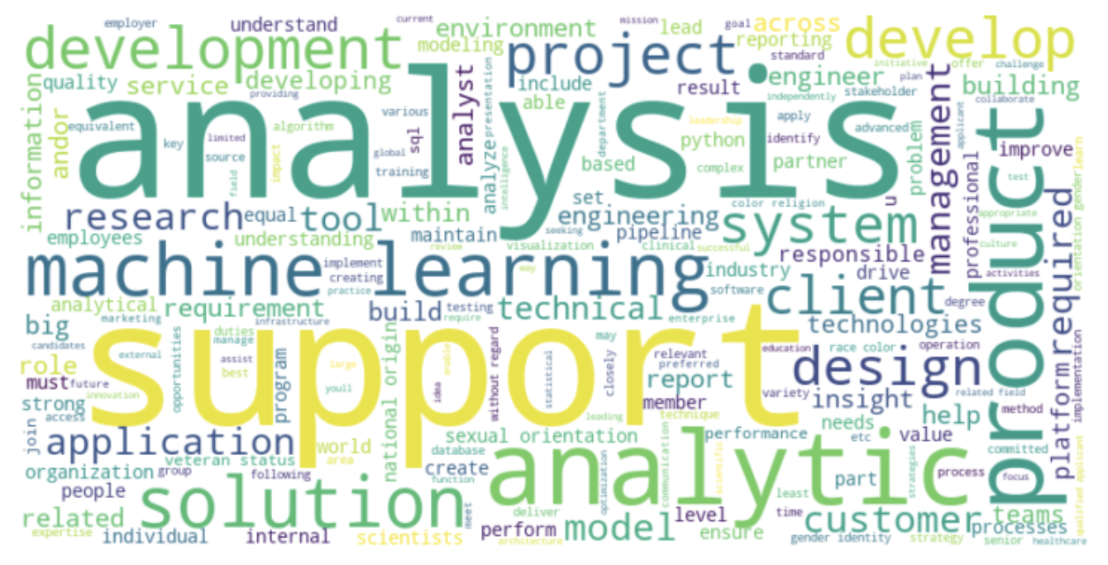
MOST FREQUENT WORDS IN JOBS LISTINGS
technical
management
support
product
service
project
analysis / analytic / analyst
insight
system
application
solution
development
research
involve working with people from other teams such as the product team and even senior managements and providing them with some support.
research as part of his or her work.
explaining or translating the technical terms for other non-technical people that is involved in the project that you are working on and also explaining on the insights that you have gotten from the analysis.

Slide 23

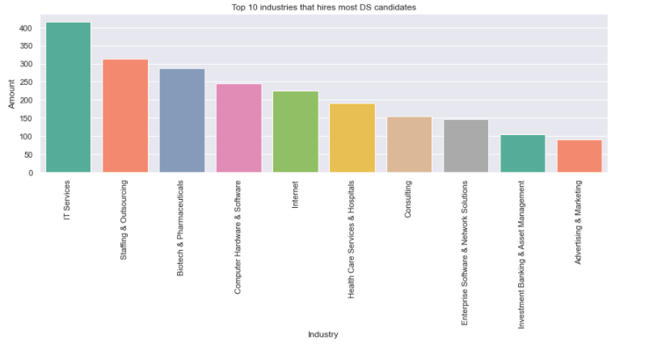
TOP 10 INDUSTRY
Dominating industry is the IT related services industry.
Existing, stable and automated system of collecting data
Other industries probably approached Staffing and Outsourcing companies to help them with the hiring process.
Healthcare, Pharmaceutical industry (Computer Vision), Investment Banking (Time series) and Advertising and Marketing industry. (NLP)

Slide 24
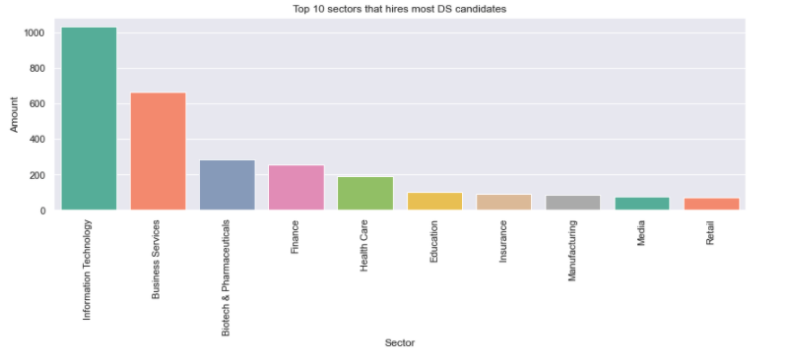
TOP 10 SECTOR
Most of the top ten sectors are also related to the top ten industry.
Information Technology, Business Services, Biotech and Pharmaceuticals, Health Care, Finance, Media.
The new sectors that were previously not mentioned are Education (NLP), Insurance, Manufacturing and Retail (time series).
possibly the ones that hire Data Scientist through Outsourcing companies.
New entrants

Slide 25
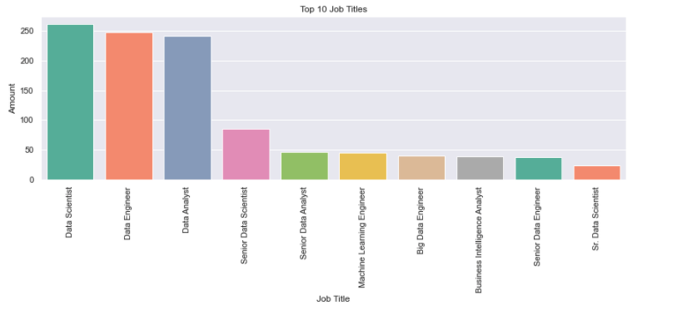
TOP 10 JOB TITLES
good mix of job positions as Data Scientist, Data Analayst and Data Engineer related titles.
not much demand for senior position in the Data engineering related roles.
most of them transition into other roles instead of remaining as a data engineer.
data engineer roles are newer compared to data analyst or data scientist, so the market has not yet reflected demand for senior data engineer

Slide 26

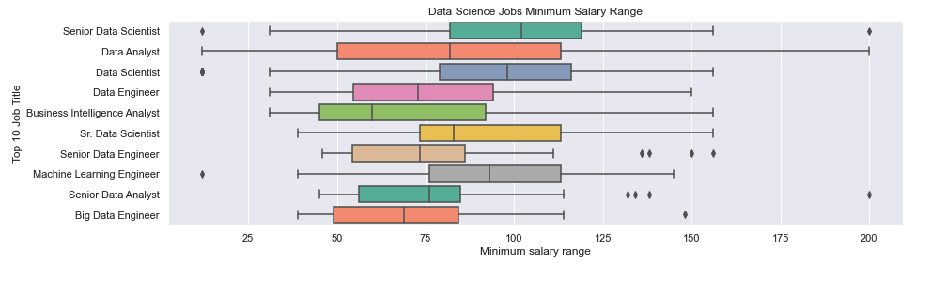
TOP 10 SALARIES MINIMUM RANGE
Start minimum range is higher for data scientist compared to data analyst or data engineer
Low outlier range for senior data scientist, data scientist, machine learning engineer
High outlier range for senior data scientist, senior data engineer, senior data analyst, big data engineer
Can enjoy more starting salary as a data scientist
However, there a small number of data scientist willing to get lower than most min salary to enter the job market
Senior roles can fetch much higher salary than average (more than 200K). These salaries are usually doled out by large tech firms
Some firms recognised the importance of data engineers and they are also willing to pay high minimum salary
Notes:
Change to boxplot

Slide 27
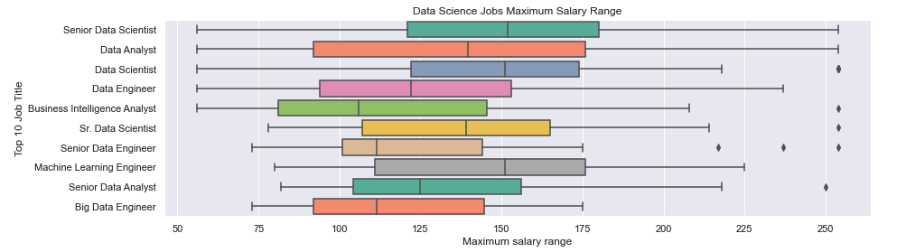
TOP 10 SALARIES MAXIMUM RANGE
Possible to get more salary as a data scientist or as much as a senior data scientist
High outlier range for
data scientist
BI analyst
Senior data scientist
Senior data engineer
Senior data analyst
Senior and non senior positions can earn as much as 250K or more. Possibility is more for senior data scientist or data analyst
As gain more experience and gain senior positions, salary variability is very similar among data scientist, data engineer, data analyst
The title ‘senior’ does not hold much distinction. A data analyst can earn even more than a senior data analyst.
Notes:
Change to boxplot

Slide 28
05
TOPIC MODELLING
How to conduct topic modelling

Slide 29
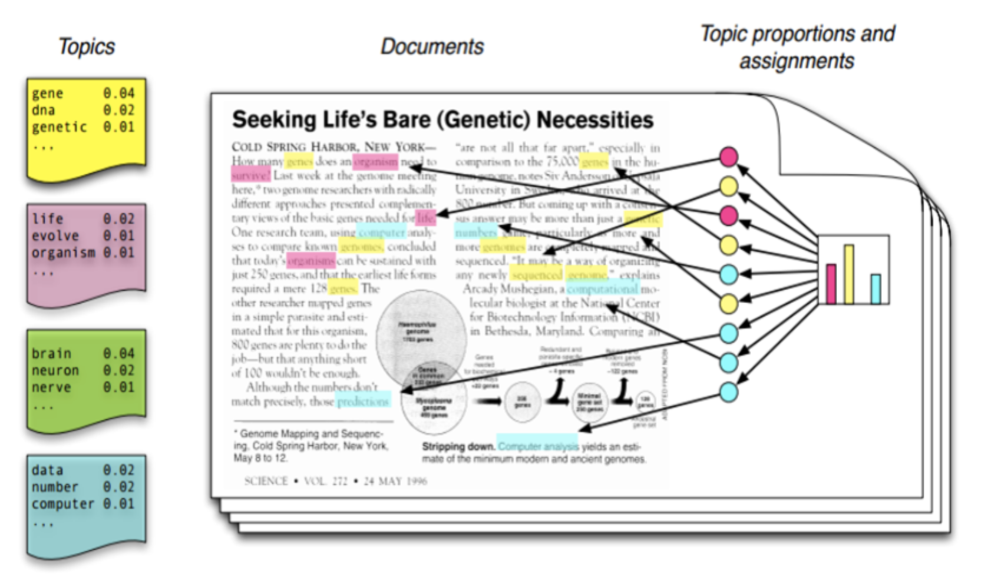
TOPIC MODELLING OVERVIEW
Topic modelling done separately for articles and job listings dataset
Latent Semantic Analysis (LSA)
Bag of words (BOW)
Term frequency–inverse document frequency (TF-IDF)
focus on reducing matrix dimension
words will occurs in similar pieces of text if they have similar meaning
Latent Dirichlet Allocation (LDA)
Bag of words (BOW)
Term frequency–inverse document frequency (TF-IDF)
each document mix with various topics and every topic mix with various words
Extract top topics and dominant documents
Libraries used is called genism

Slide 30
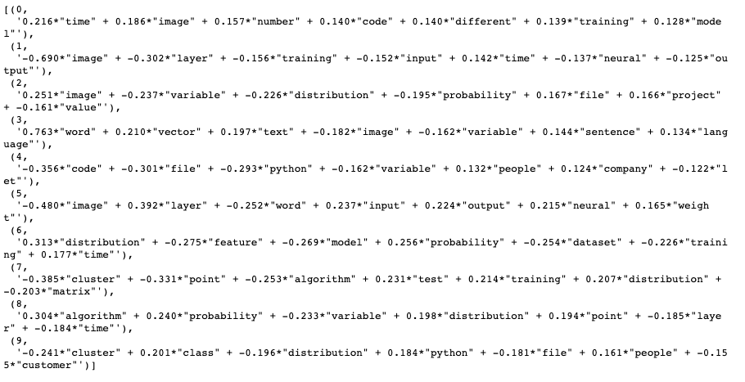
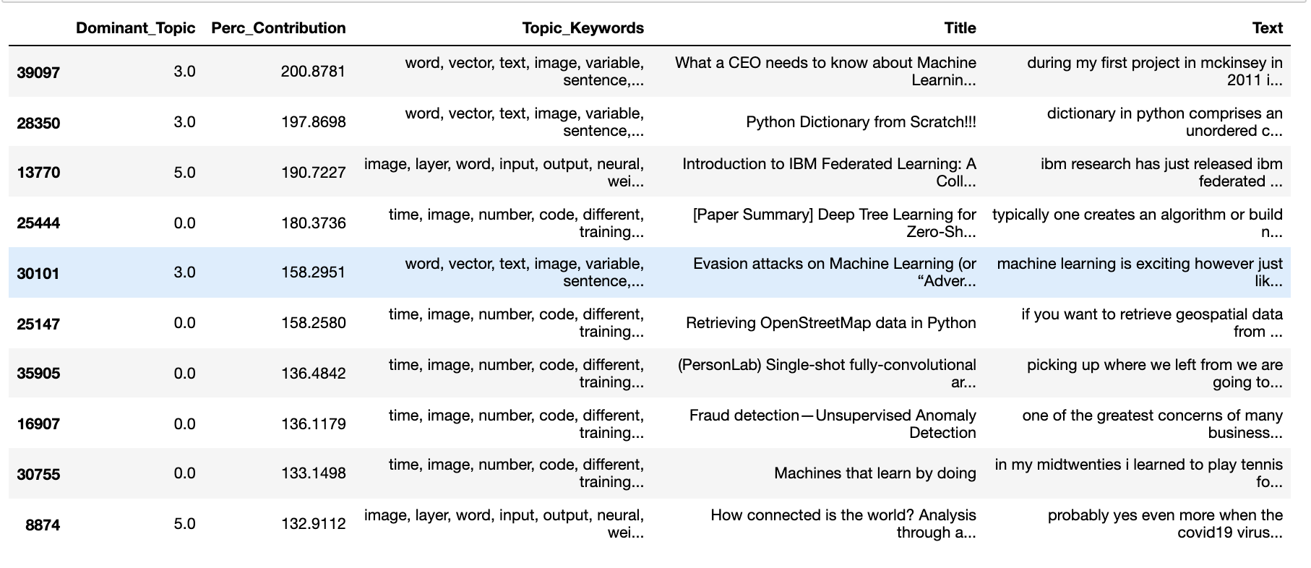
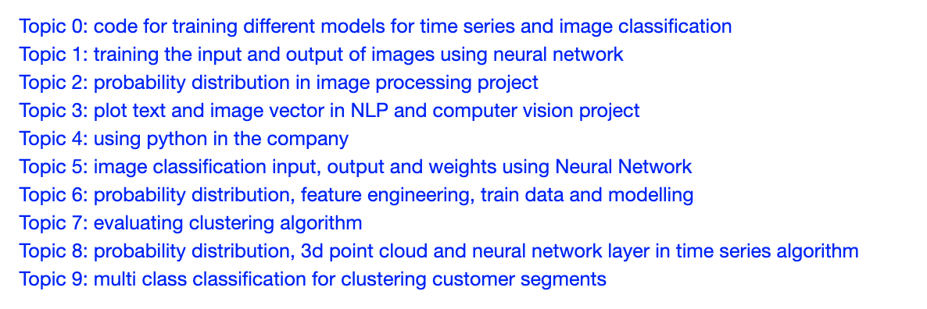
ARTICLES TOPIC MODELLING – LSA + BOW
As shown in previous EDA, most articles are on these ML branch: time series, computer vision, NLP, neural network
Dominant Topic (DT) ->Topic 0: code for training different models for time series and image classification.

Slide 31
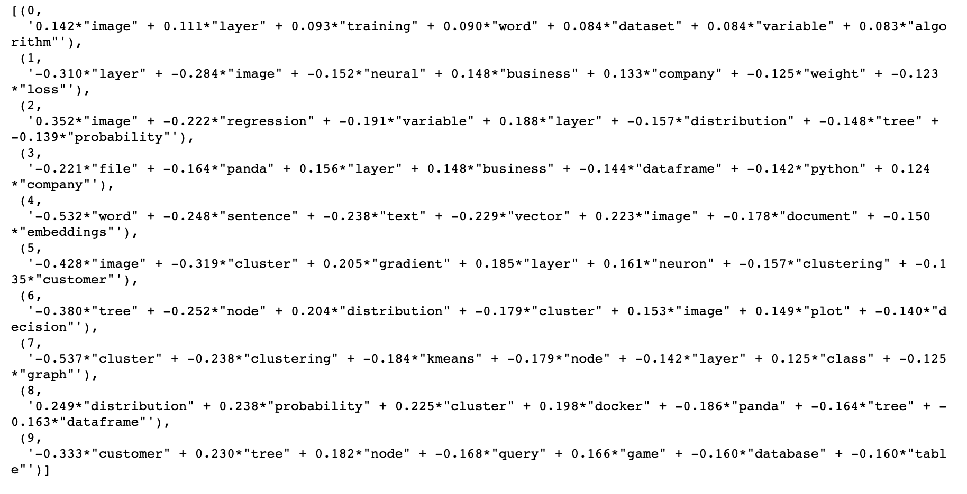
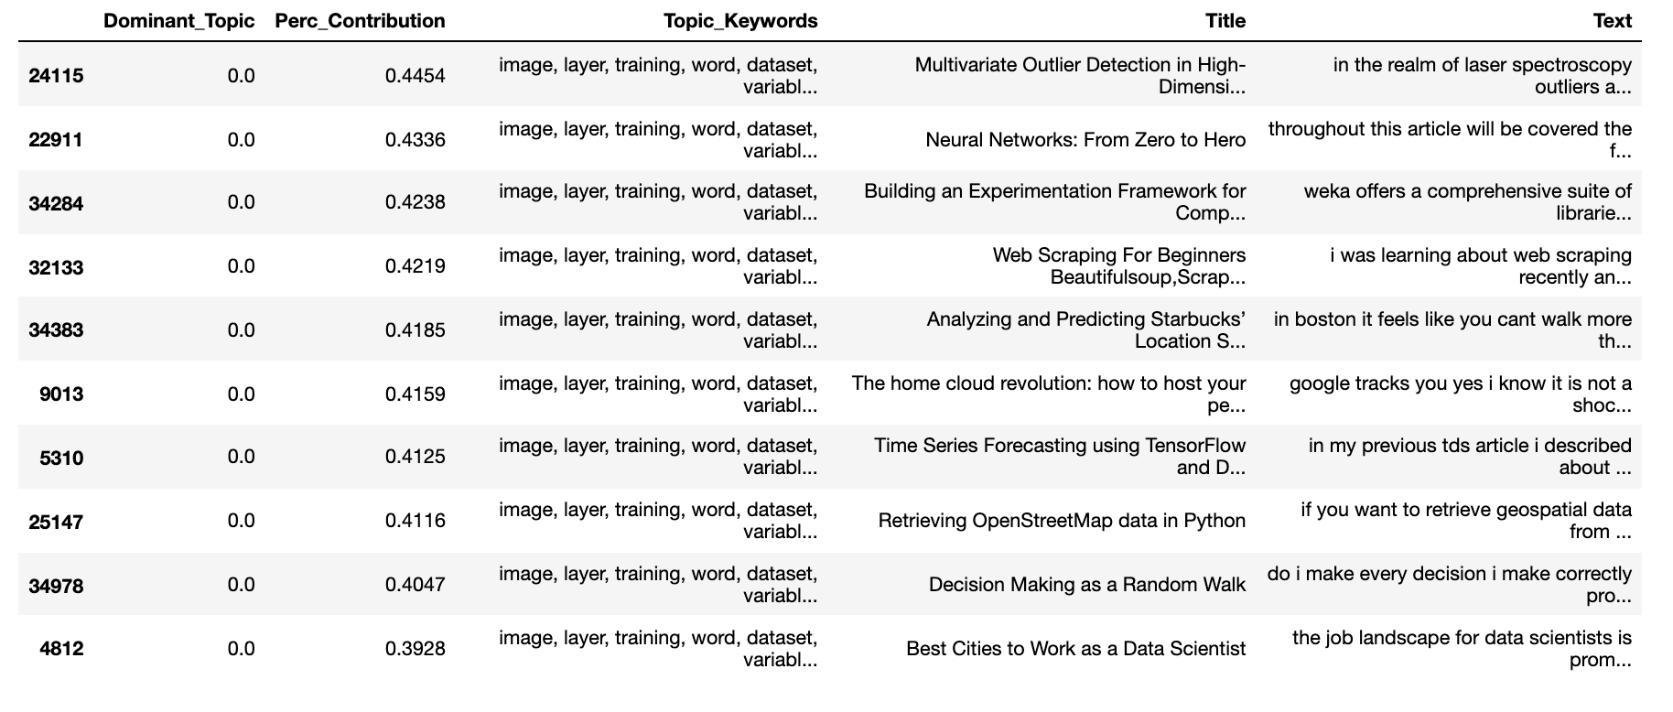
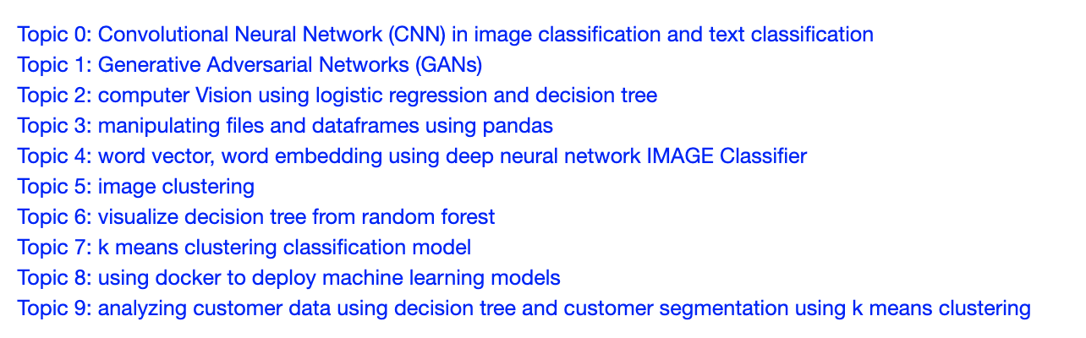
ARTICLES TOPIC MODELLING – LSA + TF-IDF
Few neural network model such as CNN, GANs are uncovered
Dominant Topic (DT) ->Topic 0: Convolutional Neural Network (CNN) in image classification and text classification.

Slide 32
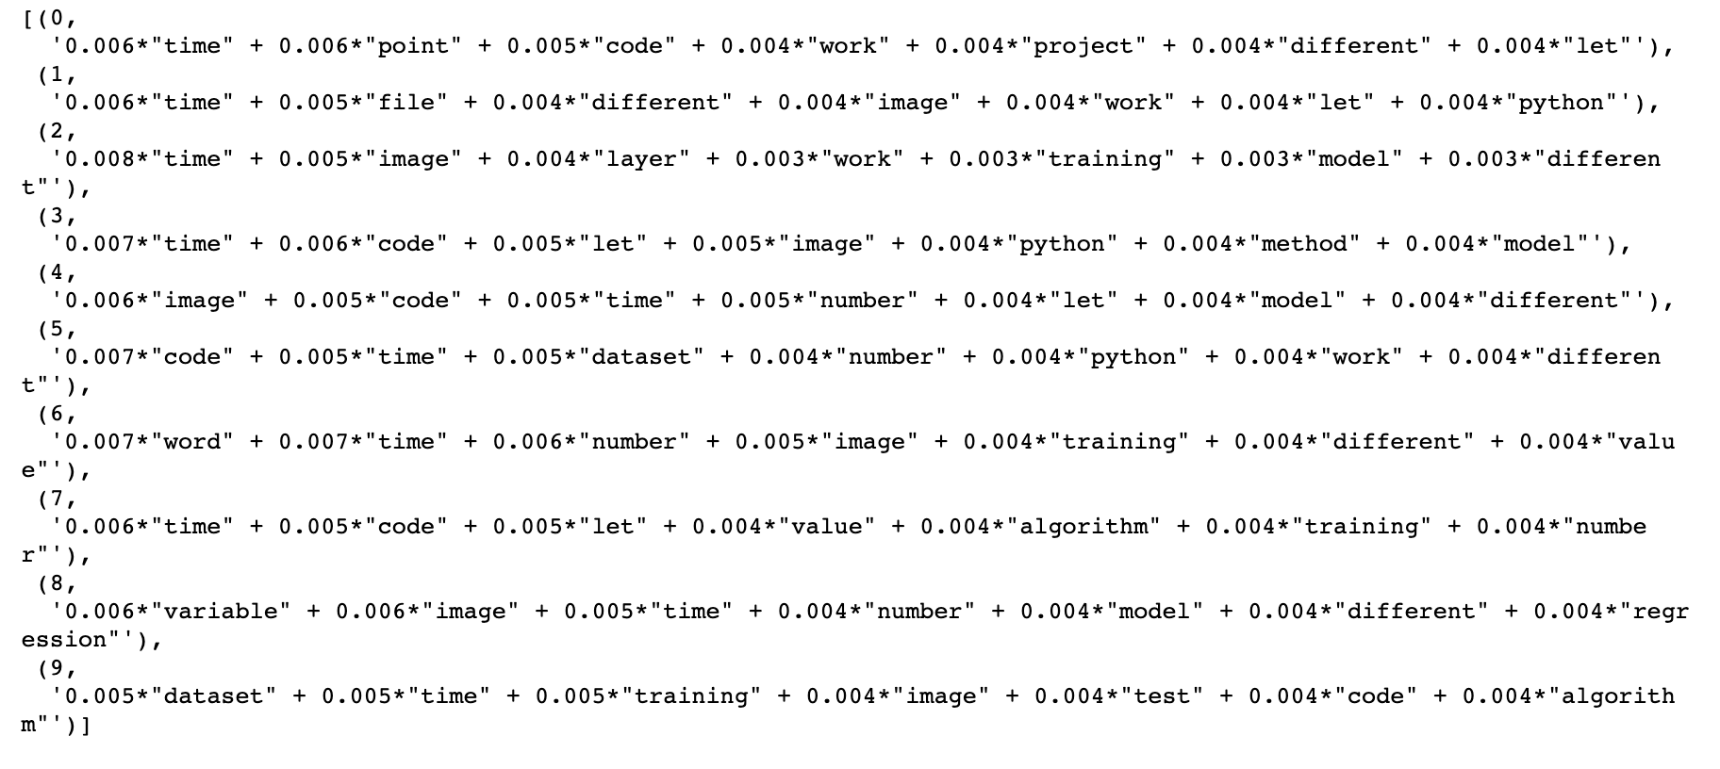
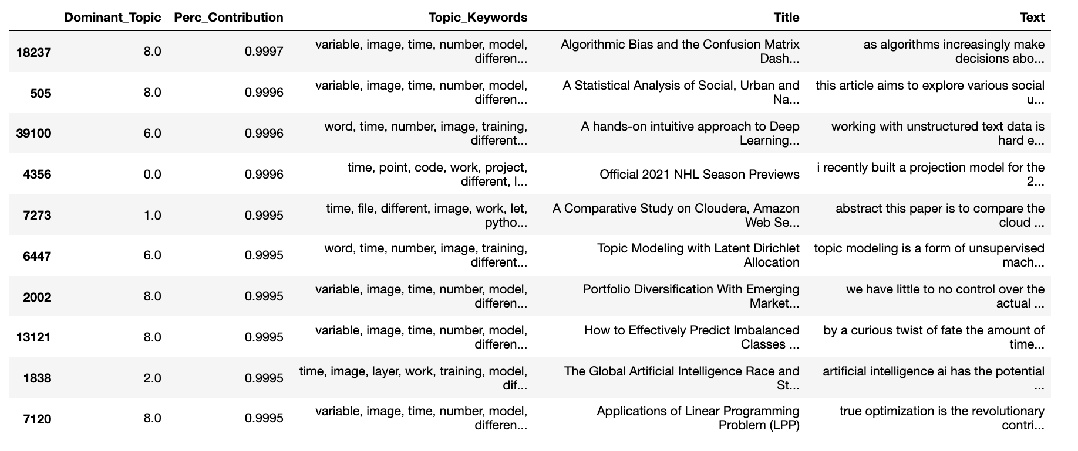
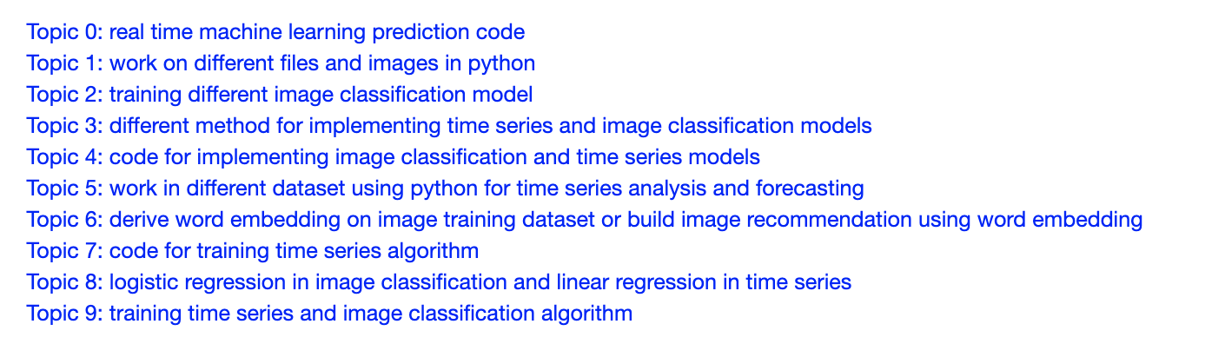
ARTICLES TOPIC MODELLING – LDA + BOW
Dominant Topic (DT) -> Topic 8: logistic regression in image classification and linear regression in time series

Slide 33
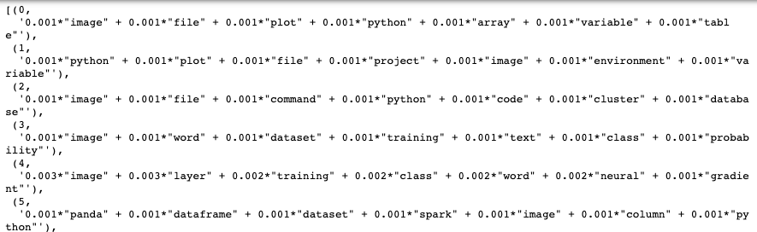
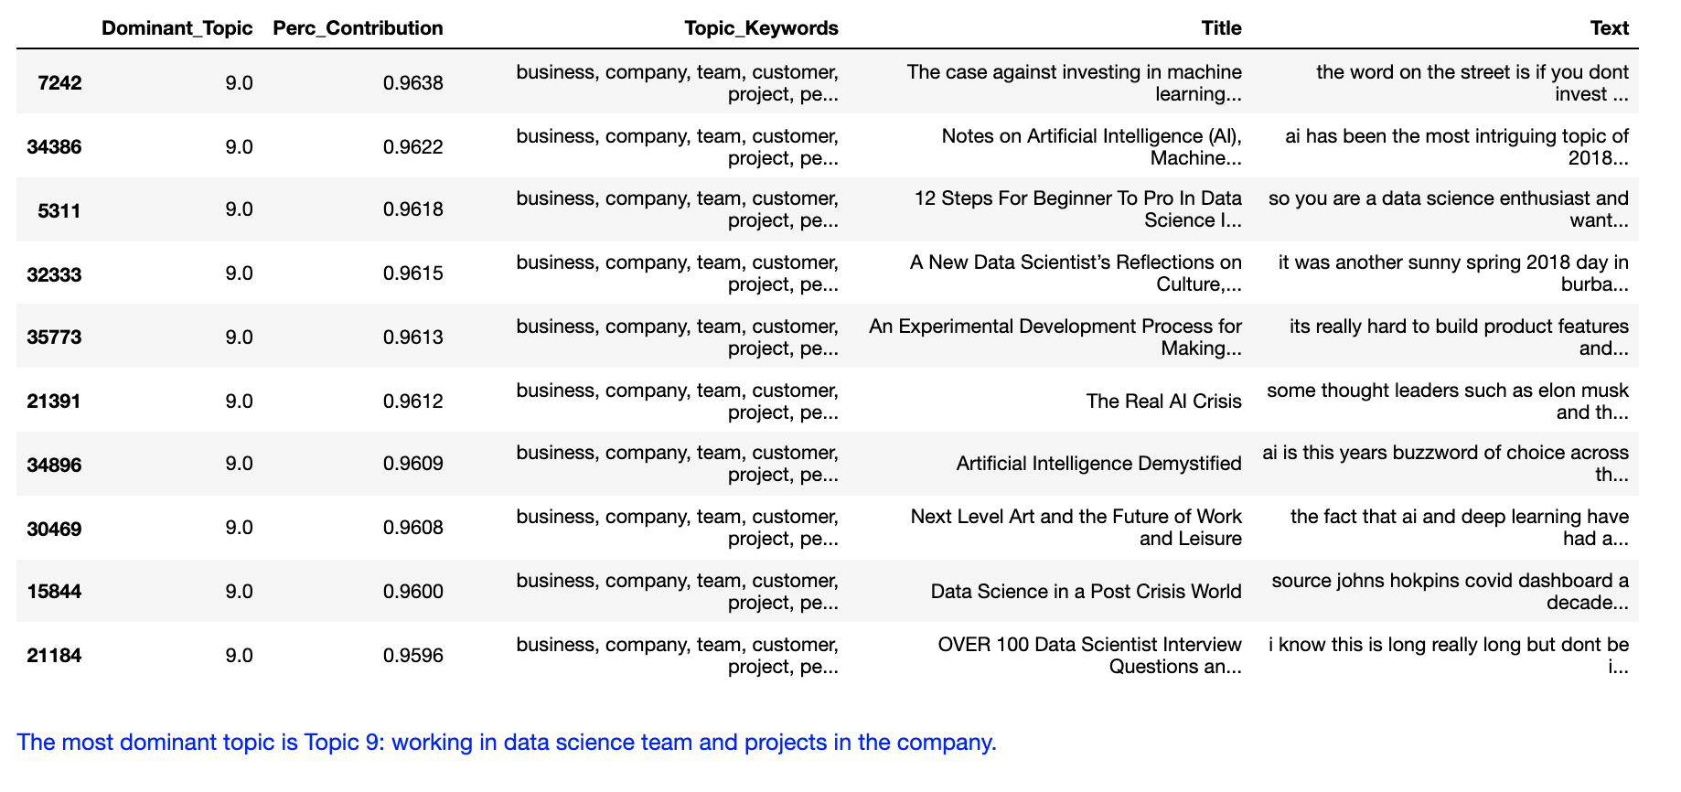
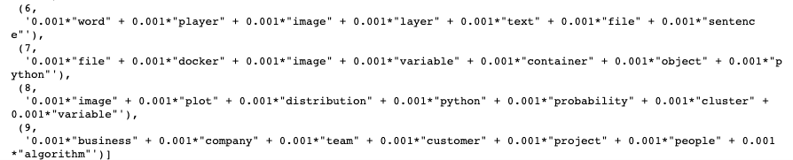
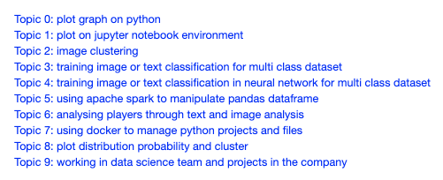
ARTICLES TOPIC MODELLING – LDA + TF-IDF
Uncover topics related to tools such as using Apache Spark and Docker and also how is actual working environment like in the company

Slide 34
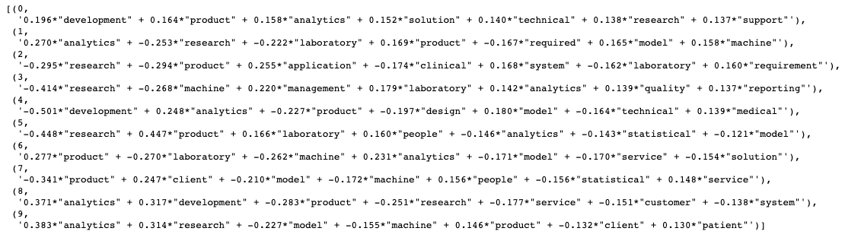
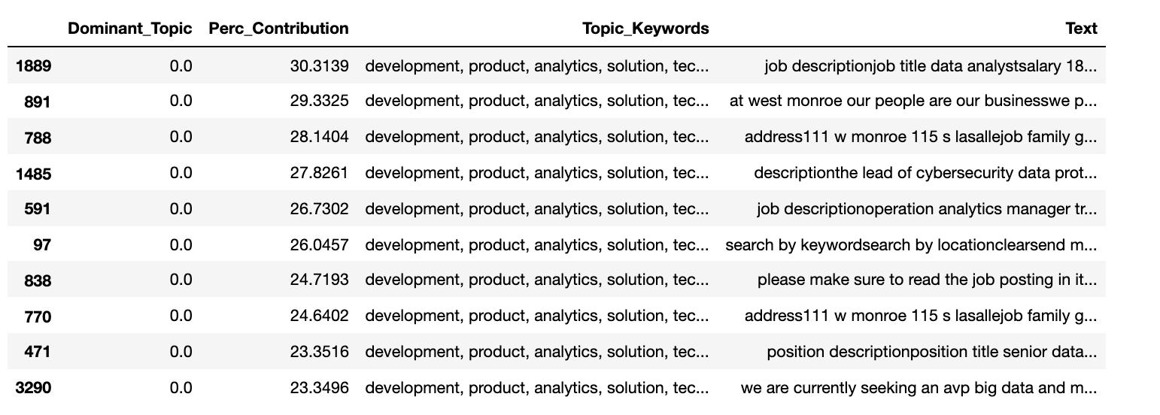
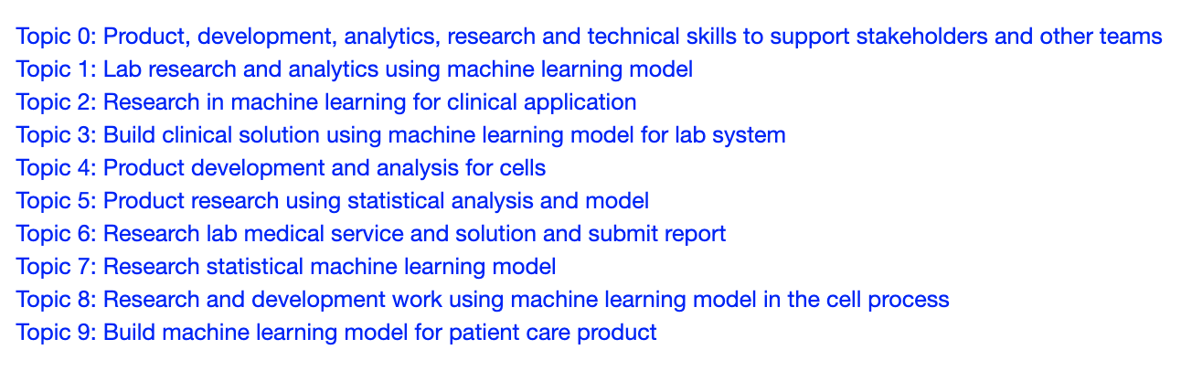
JOBS LISTINGS TOPIC MODELLING – LSA + BOW
Mix of lab and product solutions
Desired skillset: research, statistics, etc
Dominant Topic (DT) -> Topic 0: Product, development, analytics, research and technical skills to support stakeholders and other teams

Slide 35
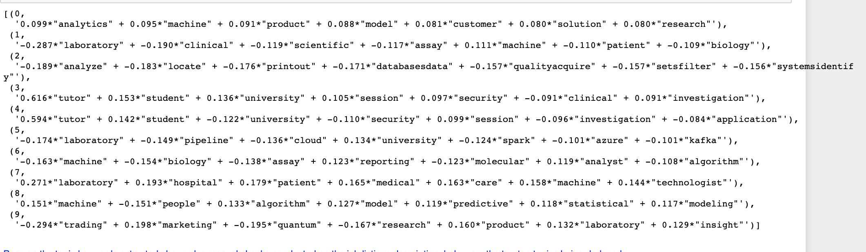
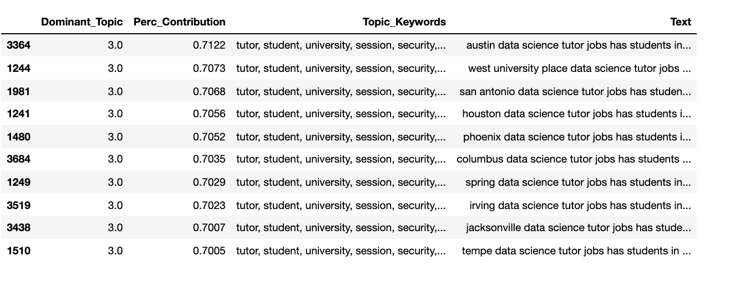
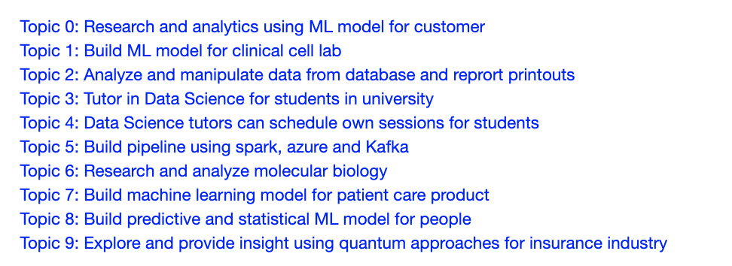
JOBS LISTINGS TOPIC MODELLING – LSA + TF-IDF
More variety of industry – insurance, tutor
More variety of skillset – building pipeline
Dominant Topic (DT) -> Topic 3: Tutor in Data Science for students in university
Singapore context : freelance as Python programming teacher

Slide 36
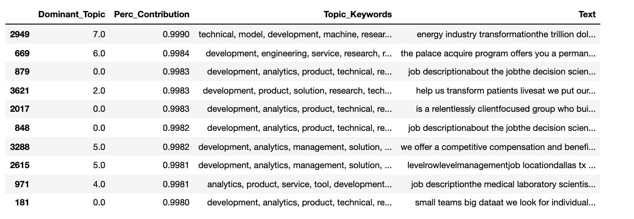
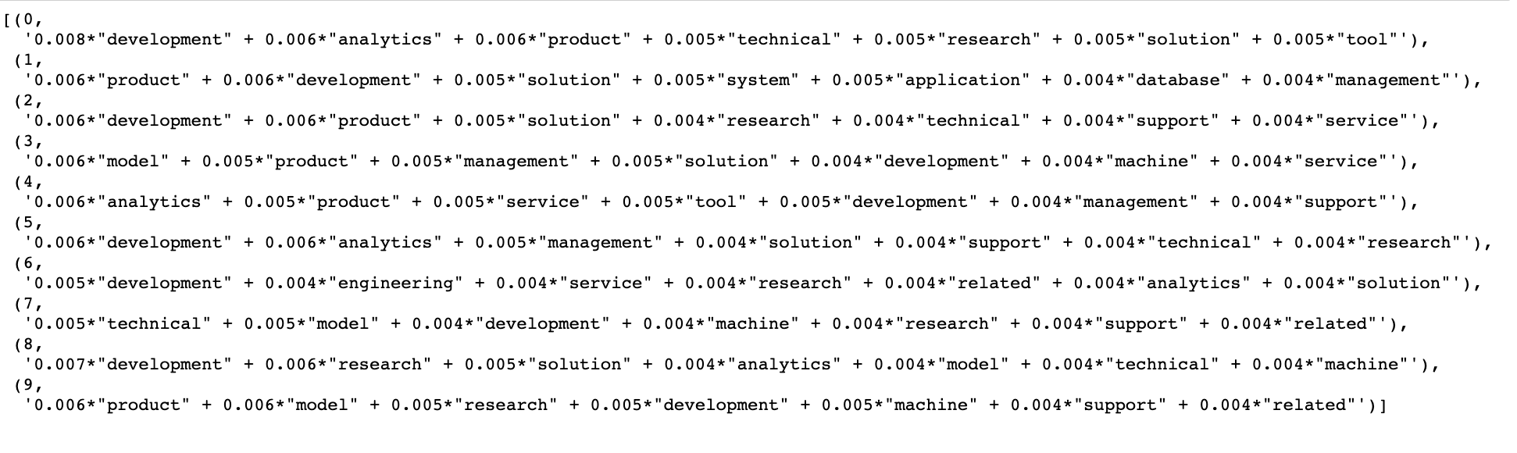
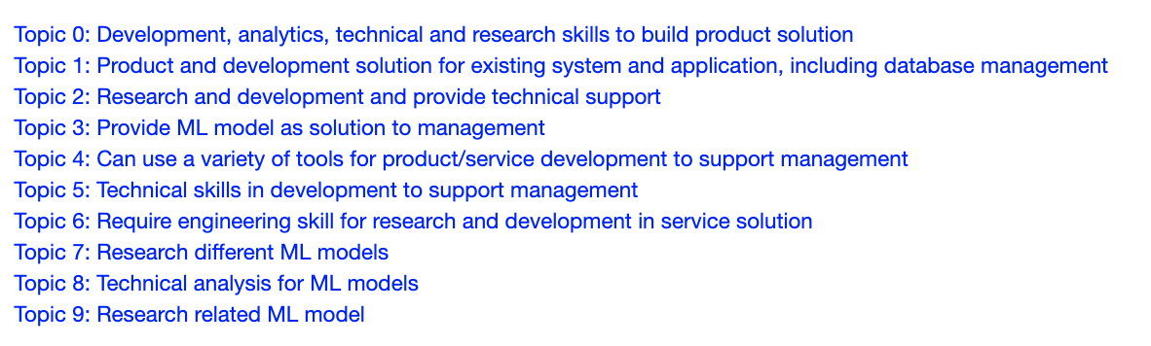
JOBS LISTINGS TOPIC MODELLING – LDA + BOW
More variety of skillset but broader terms – technical analysis
Dominant Topic (DT) -> Topic 0: Development, analytics, technical and research skills to build product solution

Slide 37
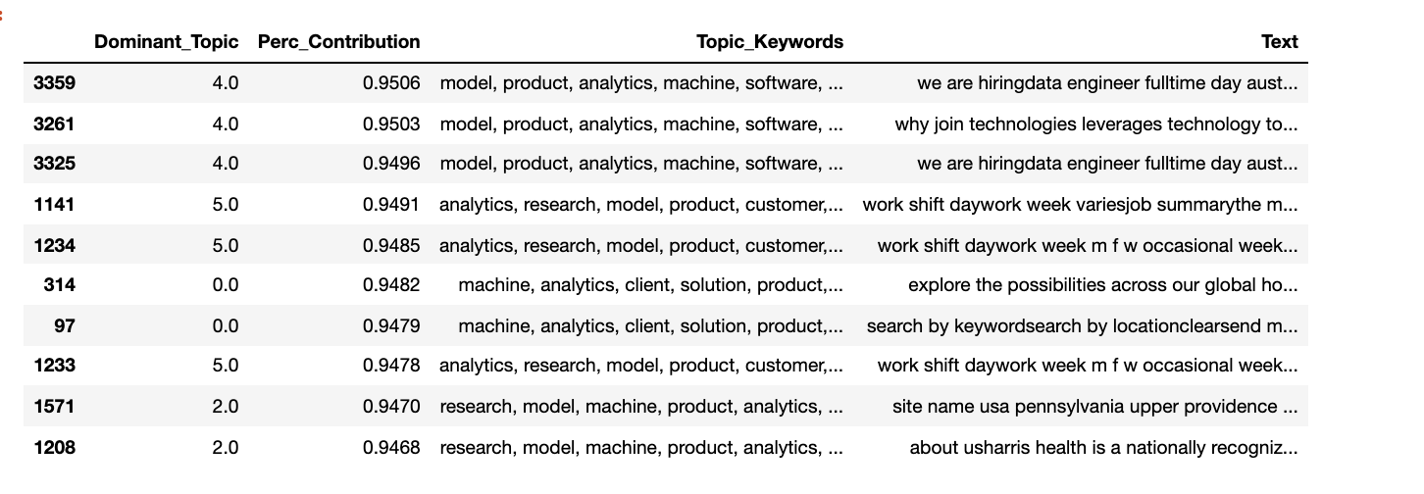
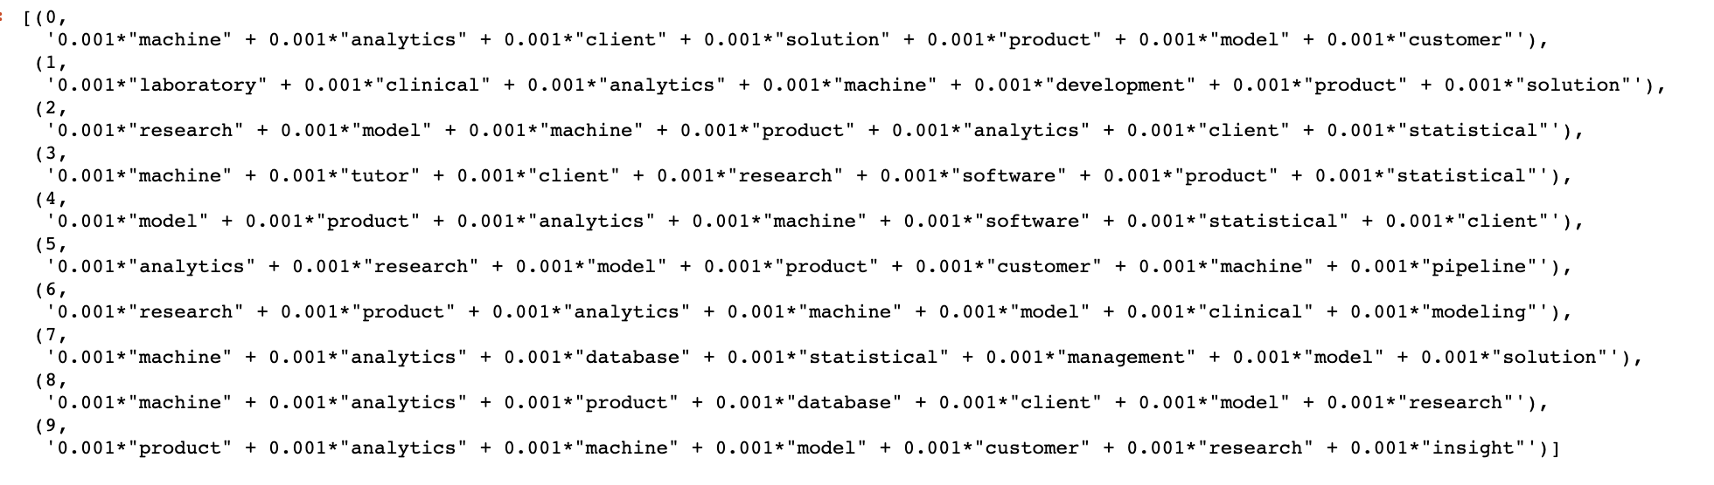
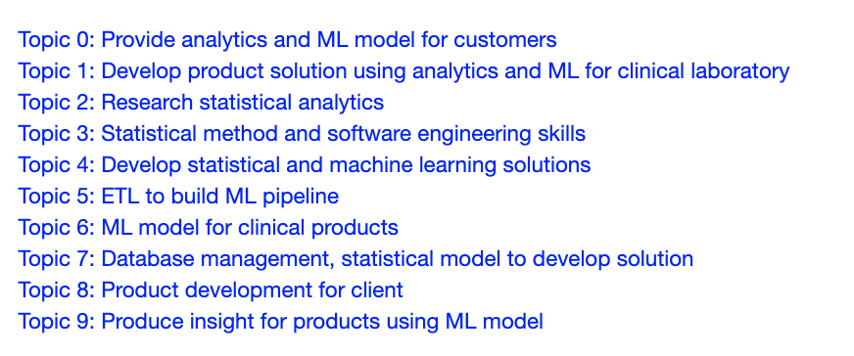
JOBS LISTINGS TOPIC MODELLING – LDA + TF-IDF
More variety of skillset – database management
Dominant Topic (DT) -> Topic 4: Develop statistical and machine learning solutions Topic 5: ETL to build ML pipeline
Encapsulates data scientist and data engineer role

Slide 38
CONCLUSION
EDA provide some clues to topic modelling result
Different Topic Modelling method can yield slightly different result – useful as some topics will not be found or missed out if just use one method
Topic extraction is the most difficult – require proper data cleaning, many rounds of training, analyzing and checking. Sometimes the topic are not so clear so above process has to be repeated
Unable to cover more in depth topic for jobs listings as the records are much lesser than articles

Slide 39
06
CHALLENGES
What kind of challenges encountered

Slide 40
CHALLENGES
Trying to find satisfactory datasets for both job articles and job listings
Ready ones are either too little or too much that require complex data cleaning
Scraping requires more time but would fit requirement better
Require more time to conduct research and apply topic modelling due to unfamiliarity
Many different libraries to select and implement (too much choice and confusion)
Require time to clean data into a suitable format before EDA and topic modelling
Require time to keep training the dataset until satisfy.
Require time and deep thinking to uncover proper topics After that still require manual checking unlike other ML solutions
Require some understanding of the subject matter of the dataset, otherwise it can be quite difficult to extract the topics

Slide 41
07
FUTURE PLANS
How to expand on the project

Slide 42
FUTURE PLANS
Expand Jobs Listings dataset and include Singapore region
Implement using different libraries but same methods and test which give better performance or results
text pre-processing,
TF-IDF/bag-of-words,
LSA
LDA
Topic Modelling using word embedding such as BERT, Top2Vec
Text summarization

Slide 43
THANKS
https://github.com/LiyanaRoslie/ds-keywords
Do you have any questions?
Please keep this slide for attribution.

